Slide 1
A Review of Action Anticipation in Human-Robot Collaboration
Pedro Amaral nMec: 93283
Seminário - MRSI

Slide 2
INTRODUCTION
The concept of Human-Robot Collaboration (HRC) involves the research of mechanisms that allow humans and robots to work together to achieve a shared goal.
The presented article aims at reviewing previous work relevant to the topic of action anticipation to enhance human-robot collaboration in industrial settings.

Slide 3
“An anticipatory system is a system containing a predictive model of itself and/or its environment, which allows it to change state at an instant in accord with the model’s predictions pertaining to a later instant.”
What is Anticipation?
Robert Rosen, Anticipatory Systems: Philosophical, Mathematical and Methodological Foundations., 1985

Slide 4
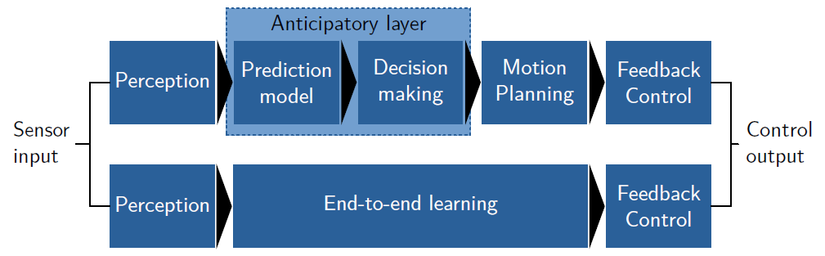
HOW TO IMPLEMENT ANTICIPATION?

Slide 5
Collaborative Robotics
Collaborative Robots and Safety in Collaboration

Slide 6
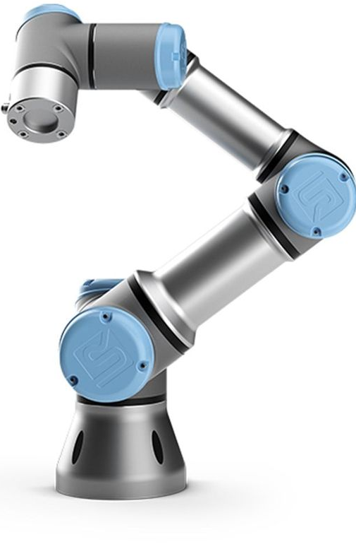
Collaborative Robots
Compact
Easy to install
Easy to program
Flexible
Mobile
Consistent
Precise
Take care of the most monotonous and dangerous actions
Reduce the production cost

Slide 7
SAFETY in Collaboration
Safety is a critical topic in Human-Robot Collaboration;
Traditional robots are in an isolated workspace so that they do not injure humans;
Collaborative robots need to be able to work with humans without injuring them;
ISO 10218-1 and 10218-2 are two norms created for this.

Slide 8
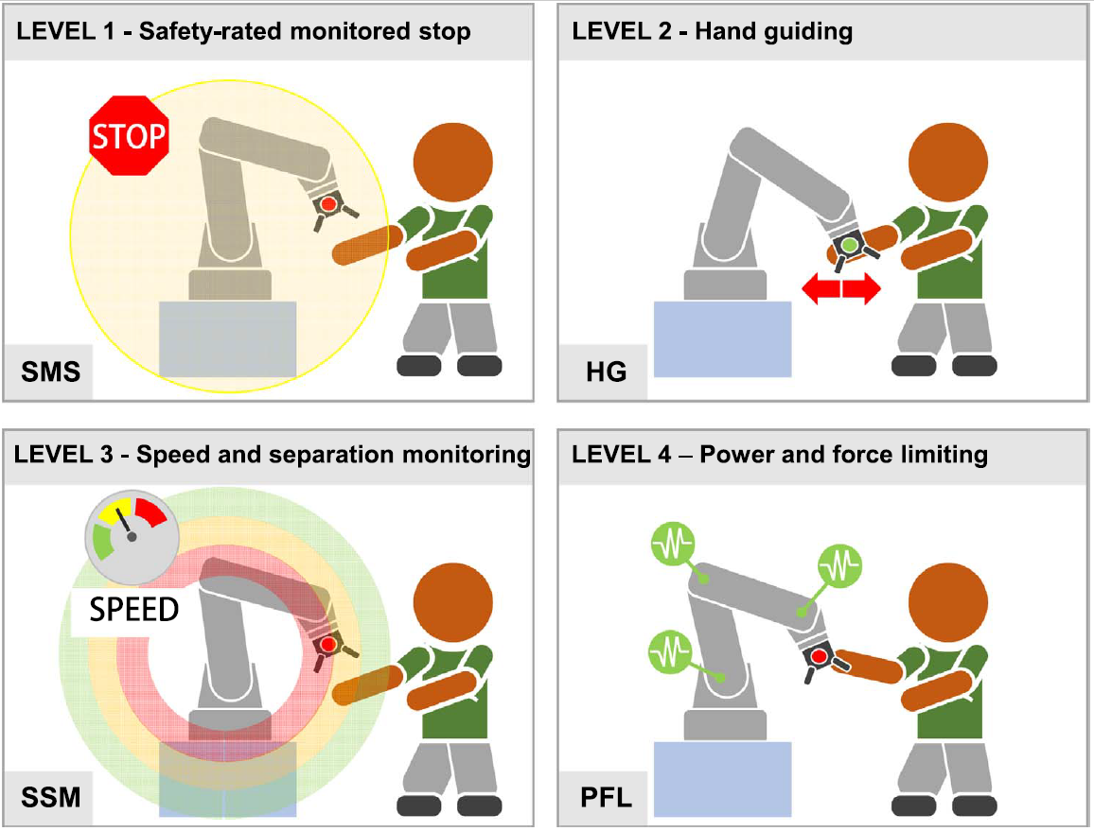
ISO 10218-1 and 10218-2 norms
Safety-rated monitored stop: when a human enters the cobot’s workspace, it completely stops;
Hand guiding: when an operator manually moves the cobot, it is compliant;
Speed and separation monitoring: as the human moves closer to the cobot, it becomes gradually slower;
Power and force limiting: the cobot has its operation restricted in terms of force and torque.

Slide 9
Data Sources and Sensors
Perception Block

Slide 10
Which Data should We Capture from the environment?
Humans and robots can communicate through several methods;
In action anticipation, passive and indirect communication methods are used;
The user should not need to do anything for the robot to act, the robot must be able to understand the worker’s body language, such as his involuntary pose, gestures or gaze.

Slide 11
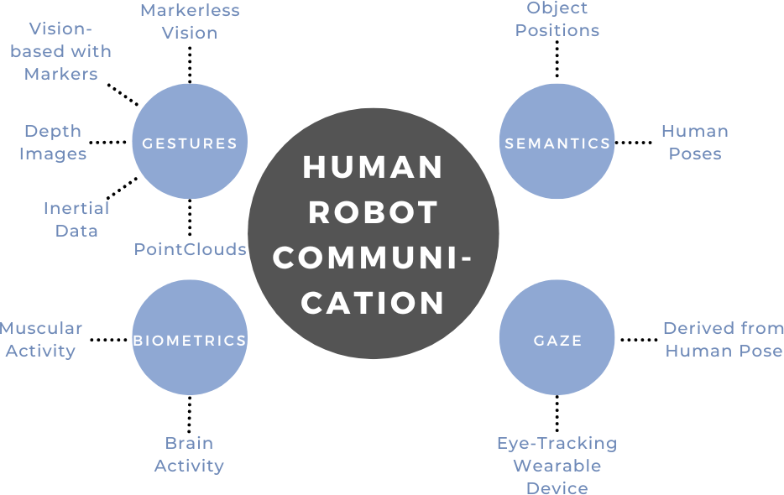
Data Sources

Slide 12
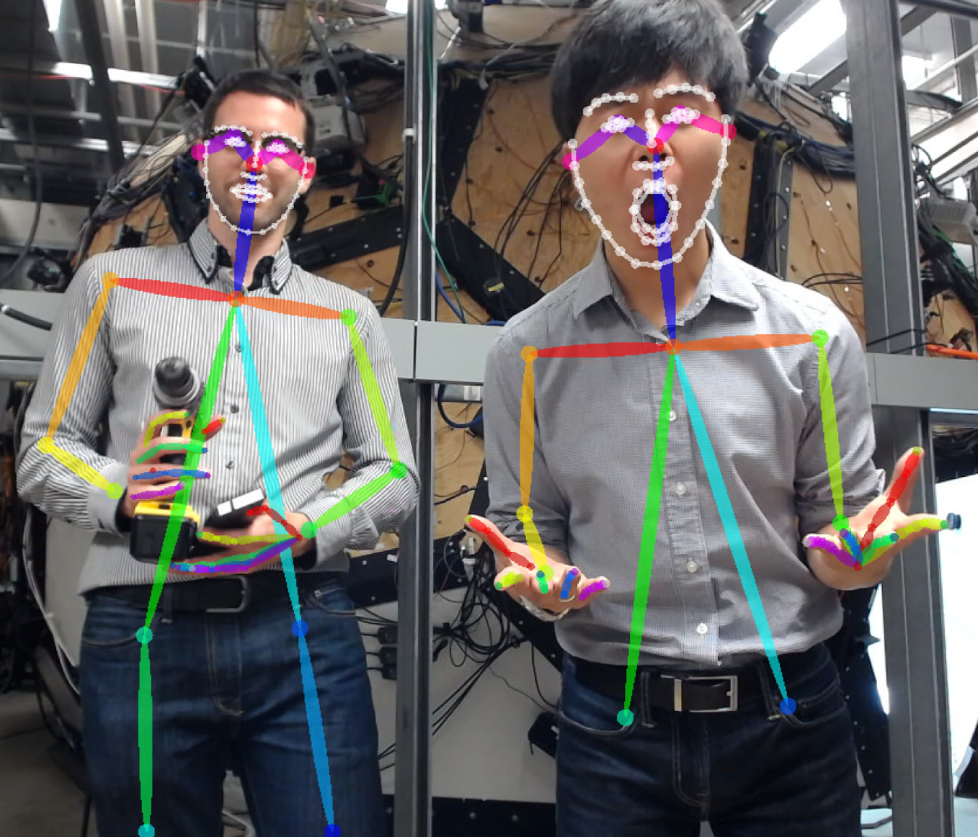
Sensors
Sensor | Nº Occurrences
RGB Camera | 9
RGB-D Camera | 1
Inertial Measurement Unit (IMU) | 1
Electromyography (EMG) Sensors | 1
Wearable Gaze Detector | 1
RGB Images can be used in different ways:
Directly in the model;
Process optical flow;
Process marker positions;
Input to key point detection frameworks.

Slide 13
Predictive Models
Prediction Model Block

Slide 14
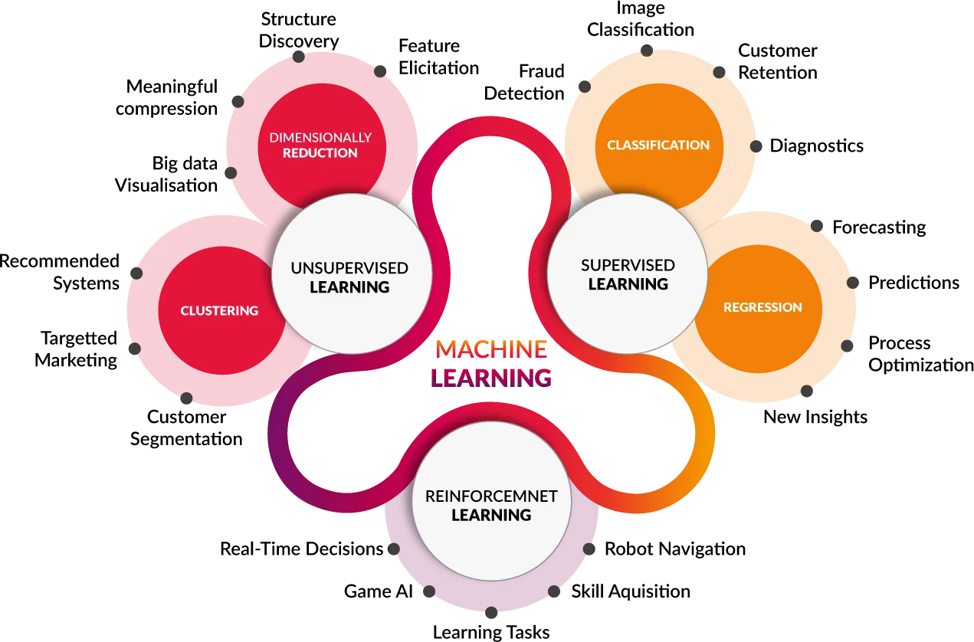
Types OF Machine Learning

Slide 15
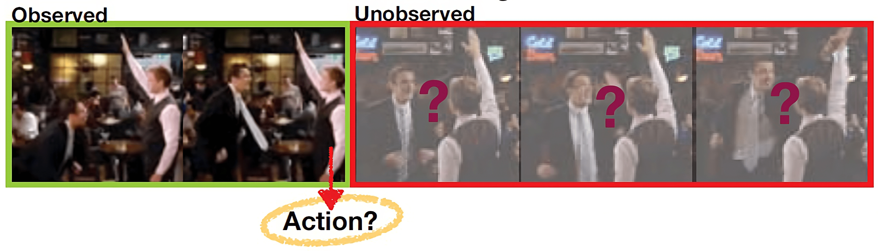
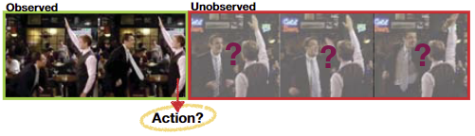
Predictive Models
Predicting the next action of the worker can be represented as a classification problem;
It is possible to use a sequence of images that must be classified as a particular future action class.

Slide 16
Predictive Models
Model Name | Nº Occurrences
LSTM | 7
CNN | 3
TSN | 1
Nearest Neighbor | 1
SVM | 1
Model Name | Nº Occurrences
ResNet-34 | 1
ResNet-50 | 1
VGG-16 | 1
TS | 1
ConvNet | 1

Slide 17
From Prediction to Planning
Decision Making and Motion Planning Blocks

Slide 18
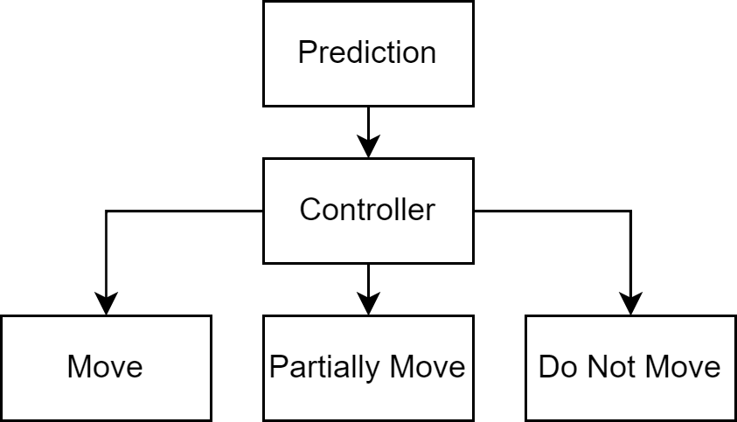
Decision-Making
Two options were found to decide when to move:
Wait until a certain level of certainty about the prediction to make the needed action;
As soon as it makes a prediction with a certain certainty threshold start slowly moving towards the target, do the entire action after it reaches a second threshold.

Slide 19
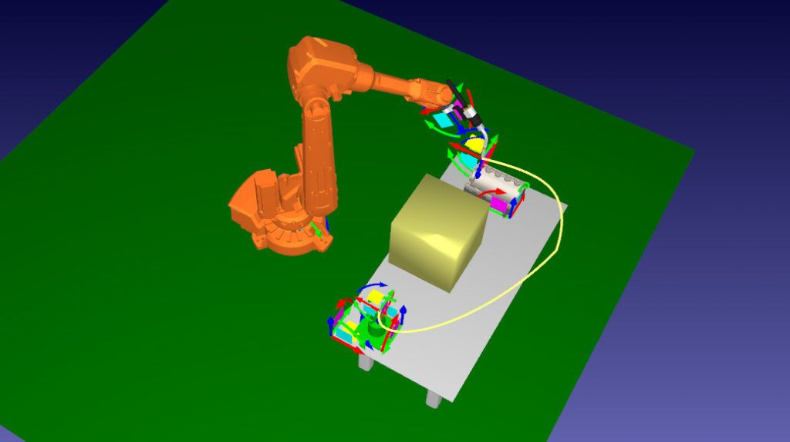
Motion Planning
Two options were found to decide when to move:
Use ROS Open Motion Planning Library (OMPL) and MoveIt! to handle the trajectory planning jobs;
Plan trajectories considering previous poses when doing this interaction to avoid collisions.

Slide 20
Summary

Slide 21
SUMMARY
There was a clear predominance of RGB cameras for perception;
LSTMs and CNNs were the most common models;
There were not many options for decision-making and motion planning;
There was not work found for an end-to-end learning approach.

Slide 22
THANK YOU

